Slide 1


Net Promoter Score Analysis
Dharahas Kandikattu
Anusha Chinthakunta Manjunatha
Mohit Anand
Rashmi Prathigadapa
Notes:
Hello everyone! Good Morning! First of all I would like to thank you for taking your time and attending this presentation. Today we are going to talk about our analysis on the NPS. My name is ….

Slide 2
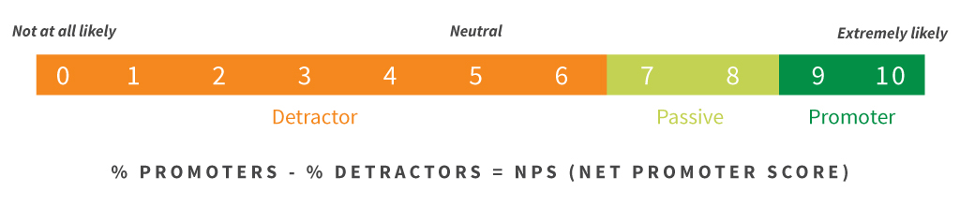
Problem Setting
Ameritas conducted a survey during the month of Dec’2018 to analyze the Net Promoter Score (NPS)
One of the questions in the survey was:
On a scale from 0-10, how likely are you to recommend Ameritas to a friend or colleague?
Notes:
Okay, lets start with a brief introduction. Many of you might be familiar that the CX team of Ameritas has conducted its first ever relationship survey in December, 2018. So, today, in our ppt we are going to walk you through our analysis on the survey results of the policy holders in order to better understand the customer satisfaction and the areas of improvement.
So, what does this survey contain?
It consists of 7 qns which assess the recipient’s evaluation of Ameritas. One of the qns was…the response to this qn was a score from 0-10. Any policy holder who gives a score on the range of 0-6 is considered as a det, … We calculate our NPS or Net promoter score using the response obtained from this qn. As you can see NPS is the difference of total percentage of prom and det. This score alone wouldn’t be sufficient because we will not be able to understand the specific areas of improvement. So, along with this we had text columns to capture the feedback from customers.
Now that we know the NPS and other survey details lets take a look at our current survey results.

Slide 3
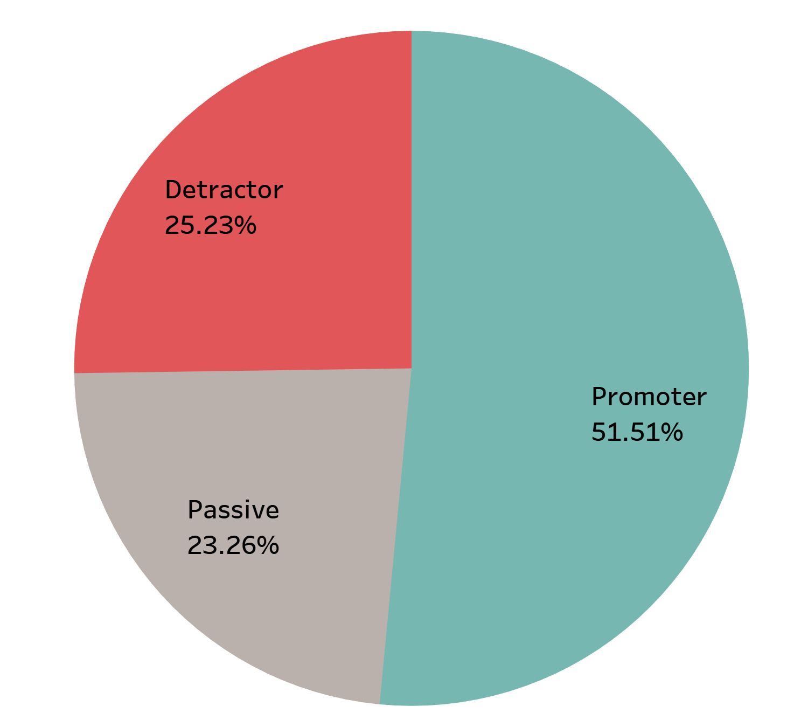
Survey Results
6855 responses were recorded
25.23% of them have been classified as Detractors
The NPS score is 26 as of 12/12/2018
Notes:
We have received responses from about 6800 policy holders which is only 10% of the total policy holders. Out of the total responses, as we can see, half of them are happy with Ameritas, which is really good. But our major concern and focus was on the other half mainly on detractors because these are the customers who are unhappy and the feedback received from them would be a good source for us to learn and improve.

Slide 4
Problem Definition
Situation: Analyze customer feedback for 12/12/2018 - Policy Holder Survey
Complication: Identify key drivers of the current NPS
Goal: Provide recommendations to increase the NPS
Notes:
Okay, let me summarize on what we have discussed so far and also discuss our agenda…

Slide 5
Data Sources
Survey data
Sales Data
Survey Responses
Customer Feedback
NPS groups
Customer Details
Policy Information
Agent Details

Slide 6
Approach
1. Topic Modeling for analyzing customer feedback
2. Machine Learning Algorithms for NPS prediction

Slide 7
Detractors Feedback Topics

Slide 8
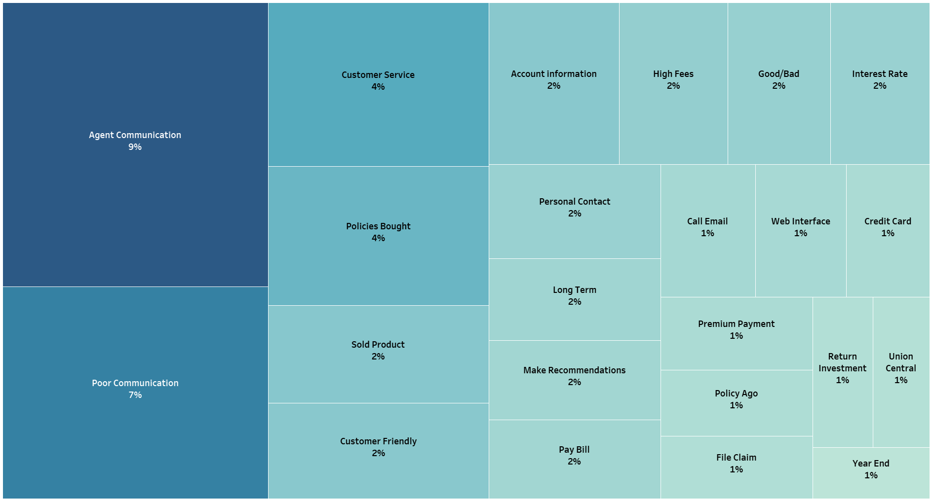

Slide 9
A Deeper Dive

Slide 10
Agent Communication (9 %)
Eg: No agent has contacted me in over 15 years
Top Terms:
contacted, hear, person, location, longer, called, representative, call left, find, heard, account, call, disappointed, heard rep, planner, financial planner, interaction, financial advisor, agent, policy, contact, representative

Slide 11
Customer Service (4 %)
Eg: lack of customer service follow up. Failure to answer simple questions.
Top Terms:
service, customer, customer service, poor, poor customer, poor service, terrible, good, horrible, rates

Slide 12
High Fees (2 %)
Eg: Your fees are way too high.
Top Terms:
fees, high, fees high, fee, high fees, annuities, annuity, funds,
returns, surrender

Slide 13
Web Interface (1 %)
Eg: Service over the phone is fine, but the web interface is very difficult to use/maintain/make changes to. Can't make a simple address change.
Top Terms:
poor, performance, experience, web, interface, web interface, portfolio, phone

Slide 14
File Claim (1 %)
Eg: Experience was not great slow process with claim I had to continue to follow up to help expedite my own claim
Top Terms:
claim, difficult, file, process, annuity, file claim, things, hard, withholding, communications

Slide 15
Key Insights
Agents need to be more responsive towards customers
Customer Website needs to be more user friendly
Frequent and better Communication (more updates)
Simplify the Claim Process
Customers expect a more Personalized Experience
Notes:
Now that we know the issues, what are the actions that we need to take??? What happens next?

Slide 16
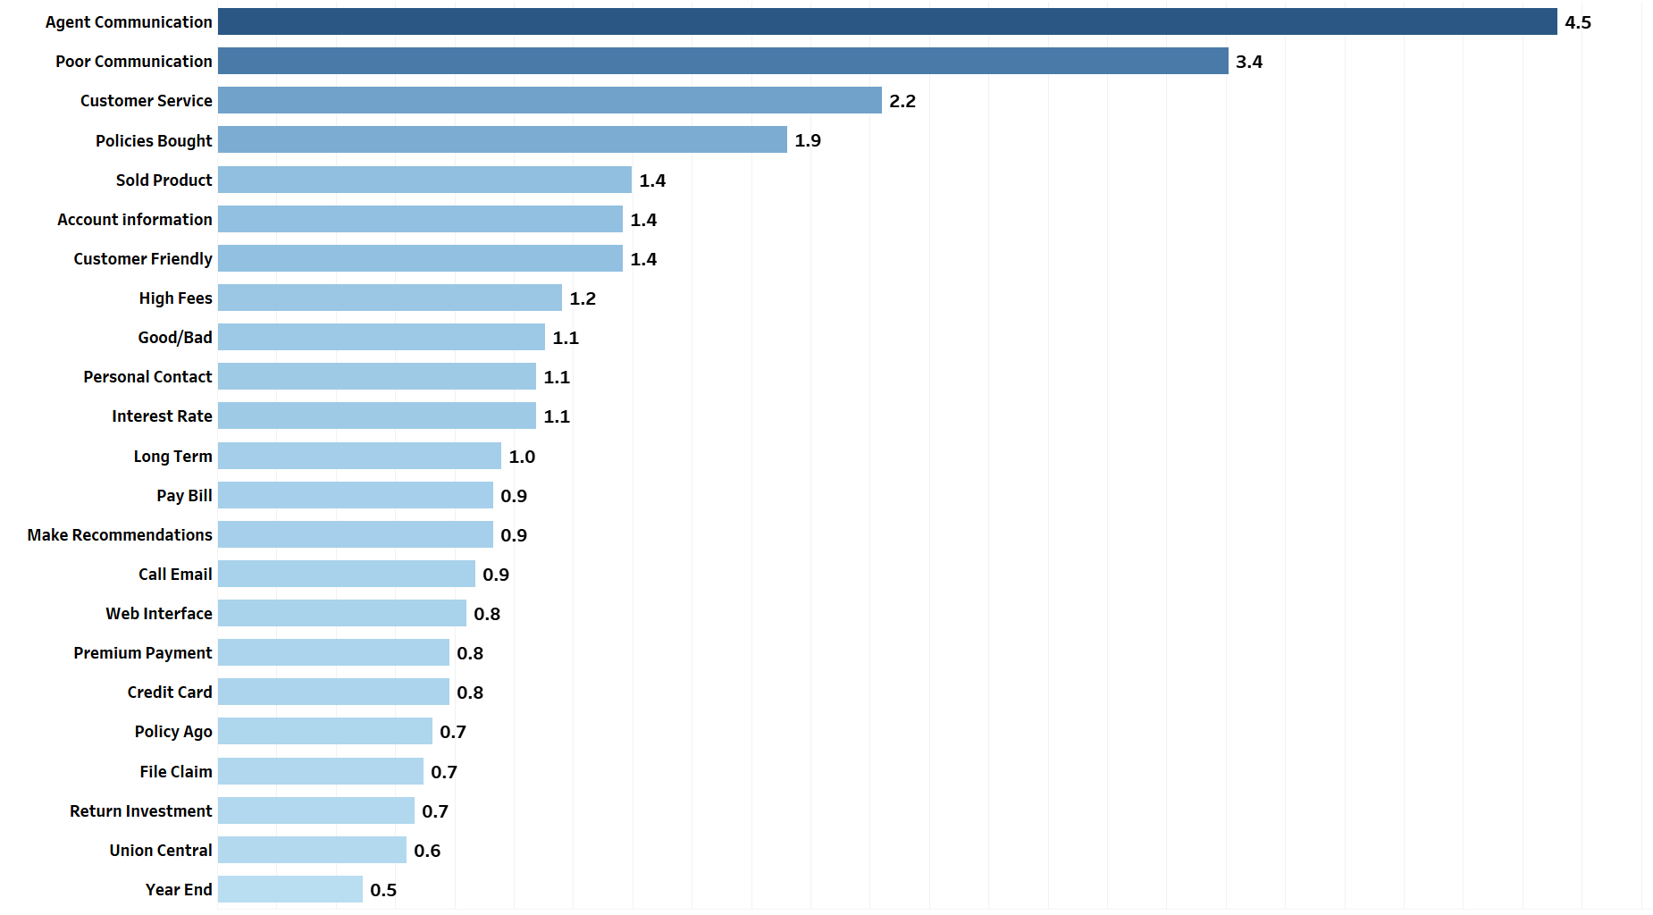
Expected increase in NPS
Notes:
There will be an increase in NPS.

Slide 17
What Next ?

Slide 18
Machine Learning
Helps identify Customer Attributes impacting the NPS
Identify potential Detractors who did not take the survey

Slide 19
Attributes impacting Detractors
Categorical
Home Agency State
Client Zip Region
Owner Age Owner Gender
Agent Age Agent Gender Agent Tenure
Policy Tenure
Monetary
Life - Annualized Premium
Life - Coverage Face Amount
Life - Net Cash Value
Life - Account Value
Annuity - Account Value
Annuity - Net Cash Value

Slide 20
Detractor Analysis

Slide 21
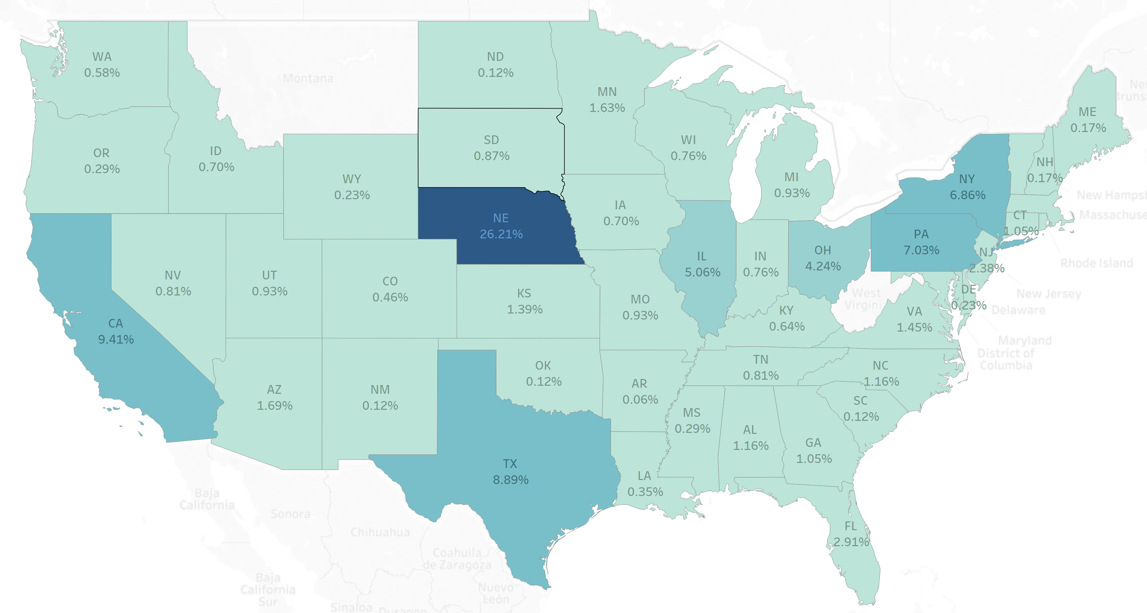
Detractors Vs Home Agency State
Percentage of Detractors by State based on survey taken on 12/12/18

Slide 22
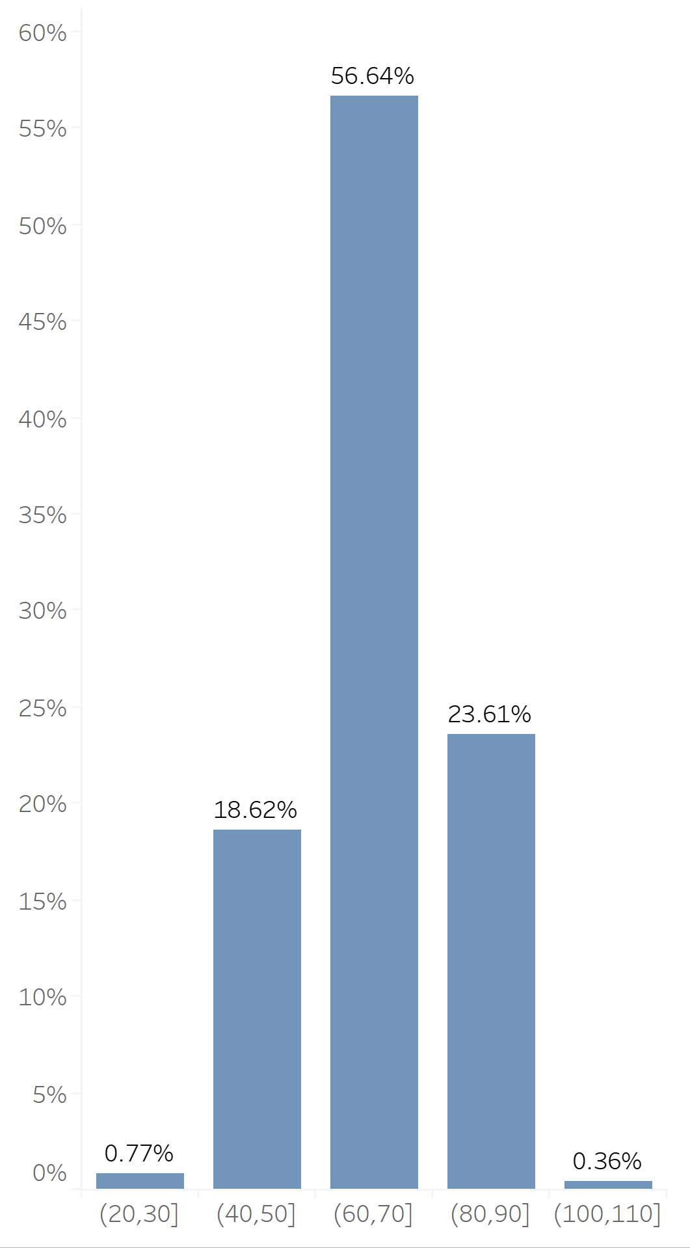
Detractors Vs Customer Age
Most of the detractors are 60-70 years old
Most of the young customers seem to be satisfied

Slide 23
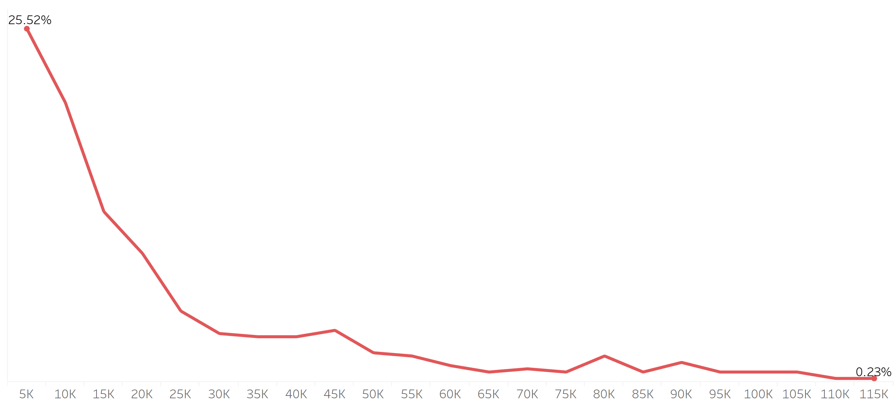
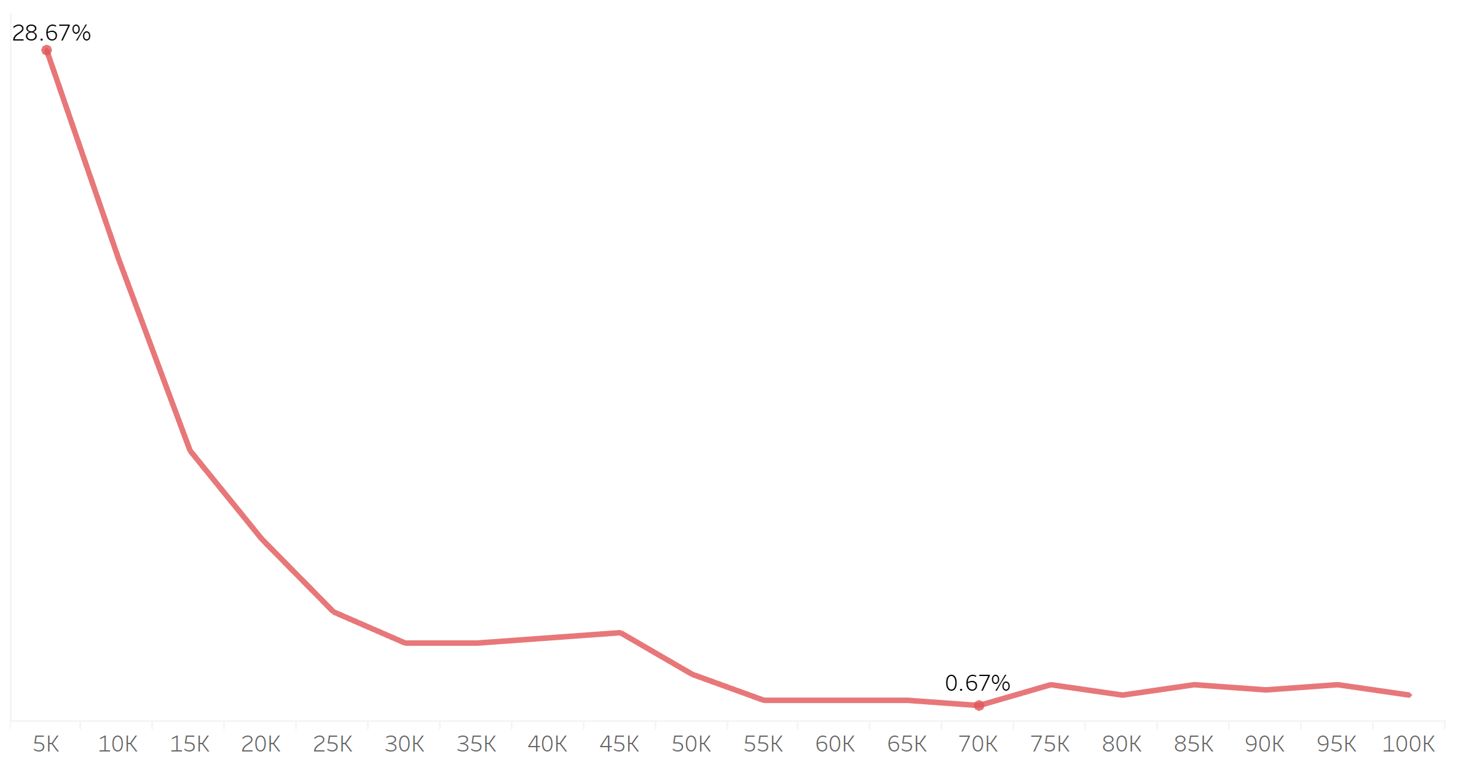
Detractors Vs Monetary Fields
Life - Account Value
Individual - Net Cash Value
As the Account Value decreases the number of
detractors are also decreasing
As the Net Cash Value decreases the number of
detractors are also decreasing

Slide 24
The Predictive Model
Method | Accuracy (%)
Logistic Regression | 74
Random Forest | 76
We finally chose Random Forest !!!

Slide 25
Recommendations
Improve communication by frequently contacting them
Launch promotional campaigns for the identified detractors
Respond to customer issues quickly
Make the website more user friendly
Incentivize customers to take future surveys
Ask feedback on changes made

Slide 26
Any Questions?

Slide 27
Thank You!

Slide 28
Appendix
Please find the code and references in the below URL: Survey Analysis Code

Slide 29
Technical Recommendations
Maintain a more Cleaner Database(can bring everything to a customer level)
Having everything at a customer Id level would be very useful for simplifying the analysis process
Can explore ensemble techniques for a better machine learning model
Can also check NLTK library in python for other topic modelling options

Slide 30
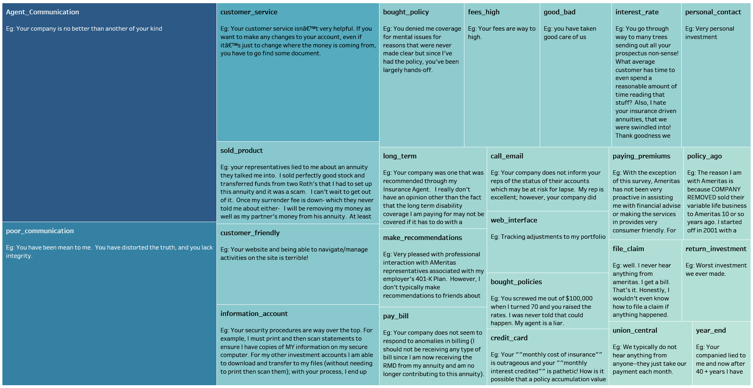
Detractors Feedback Topics from Survey Question No. 3

Slide 31
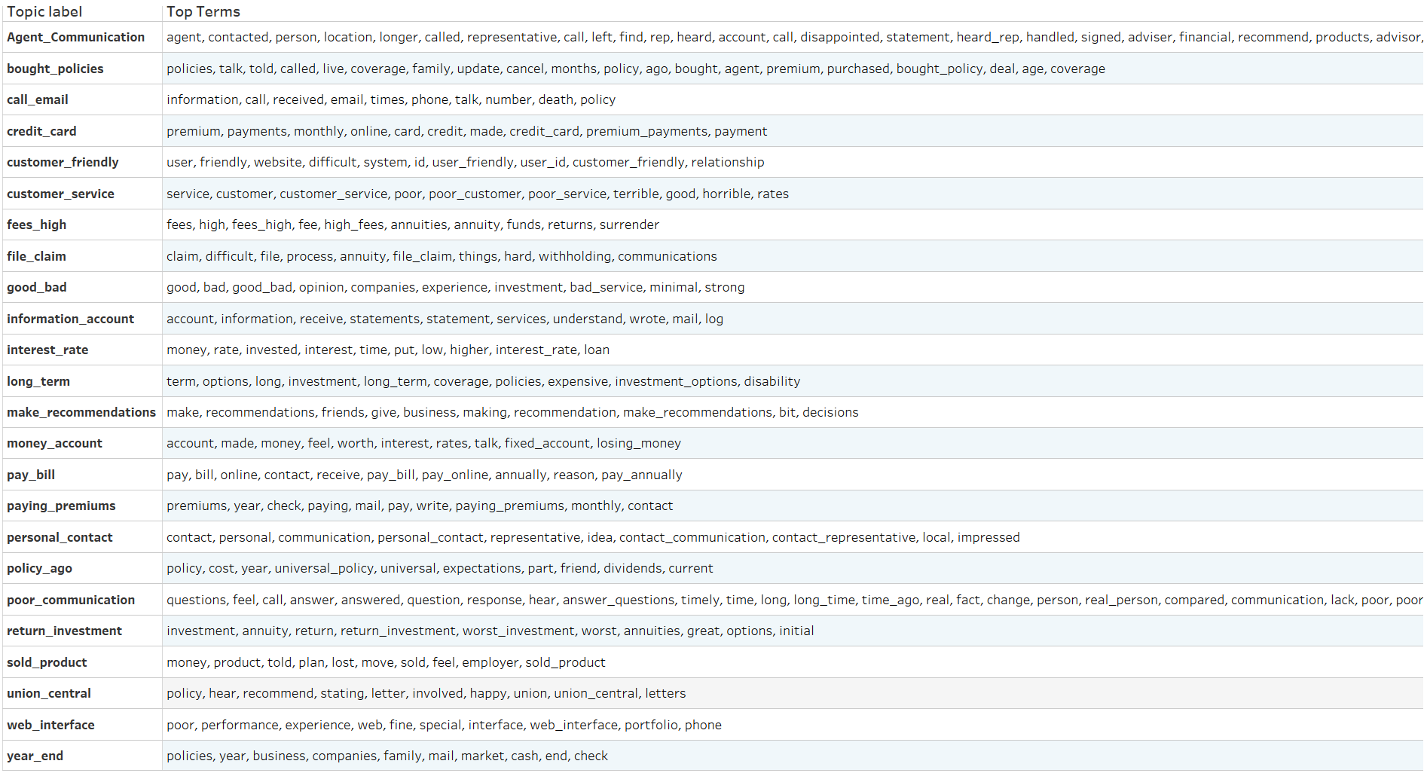
Topics and Top Terms from Q3 (Detractors)

Slide 32
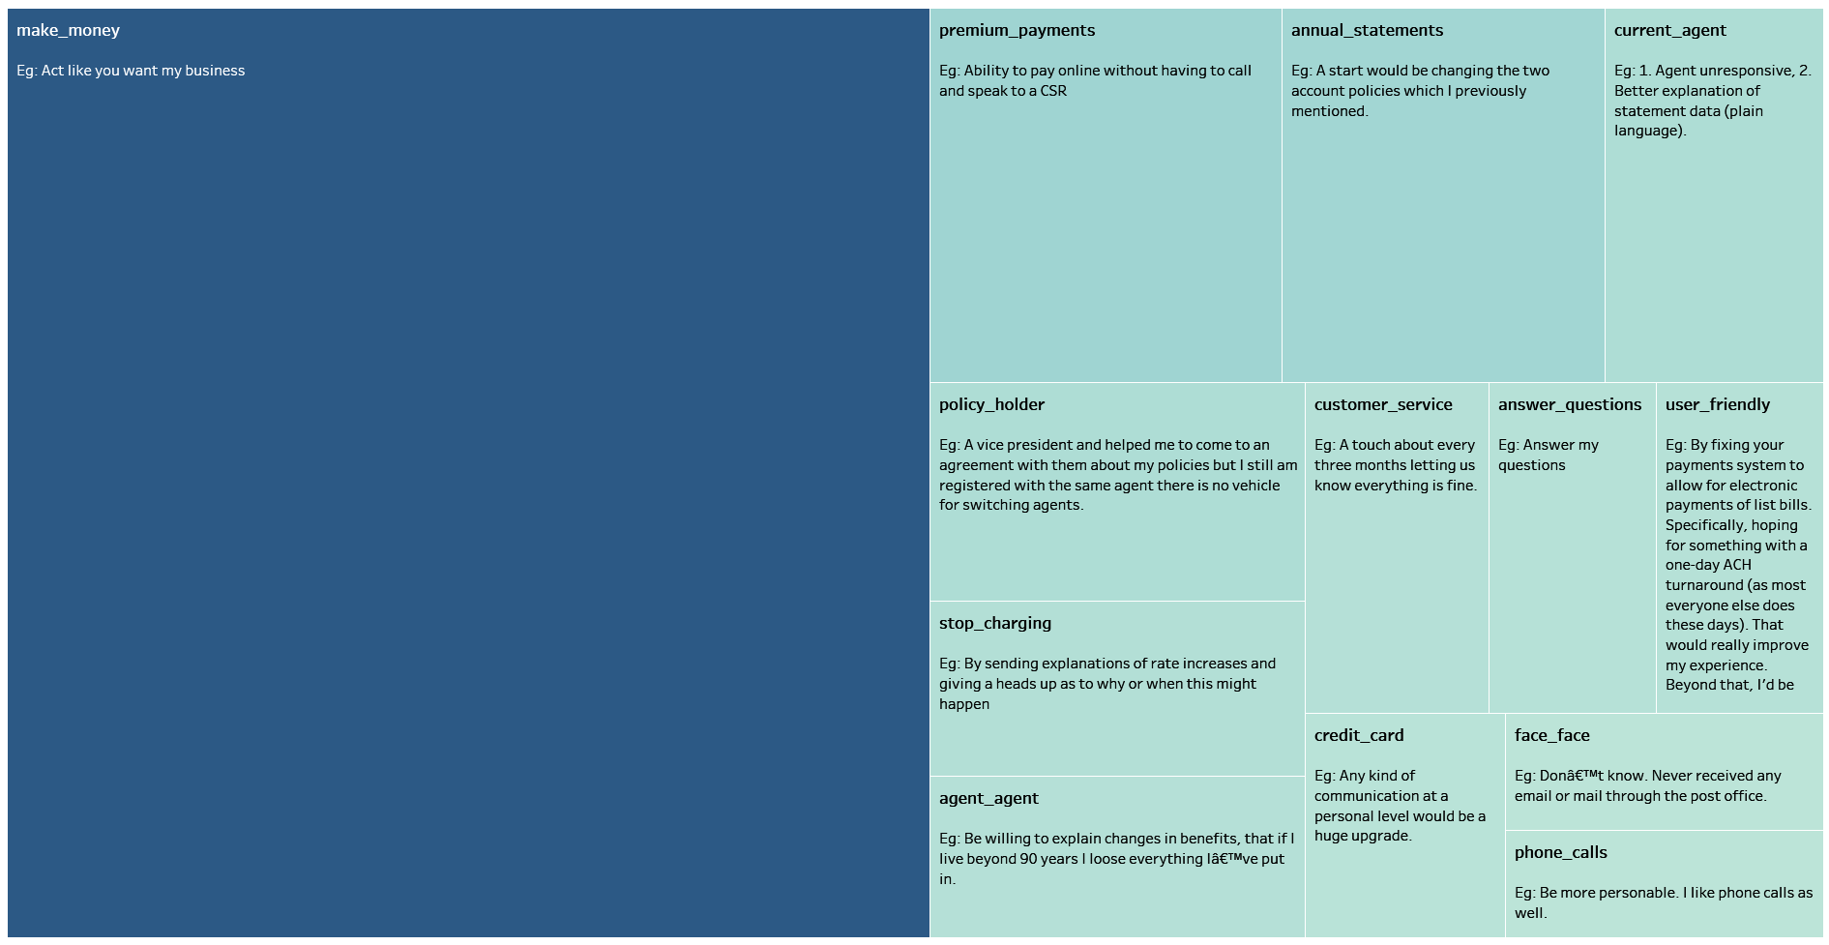
Detractors Feedback Topics from Survey Question No. 8

Slide 33
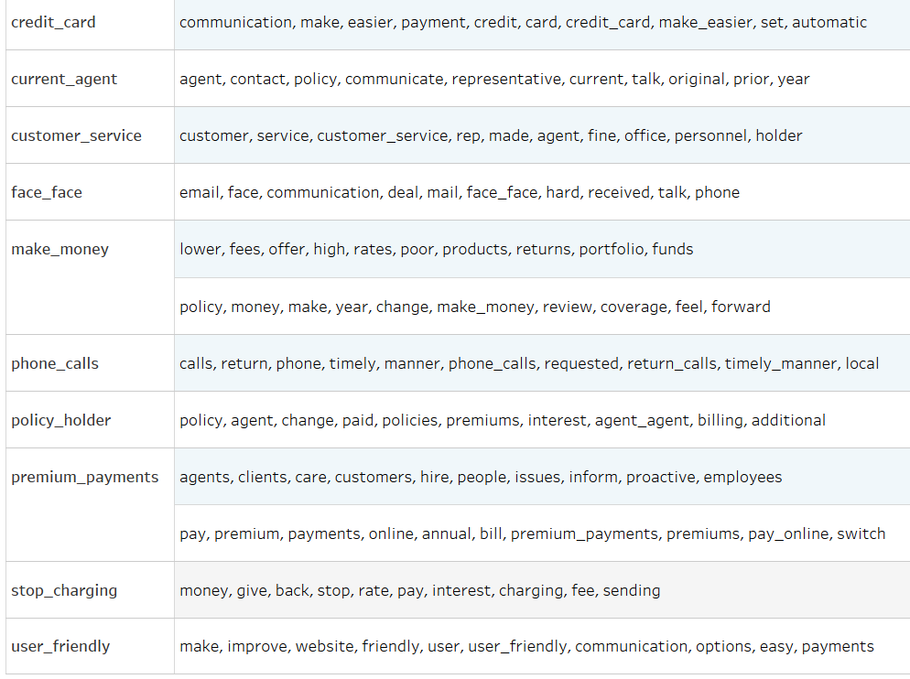
Topics and Top Terms from Q8 (Detractors)

